Slide 1
19AIE315 AI IN SPEECH PROCESSING
Hindi ASR using XLSR –Wav2Vec2
Team - 5

Slide 2
Team Members
Deepthi Sudharsan | CB.EN.U4AIE19022
Harish k | CB.EN.U4AIE19029
U Asmitha | CB.EN.U4AIE19065
Roshan Tushar S | CB.EN.U4AIE19071

Slide 3
TABLE OF CONTENTS
01
02
Introduction
Literature Survey
03
04
Model - XLSR -Wav2Vec2
Results and Conclusion
About speech recognition
Related works
Dataset Description and model architecture
Results obtained from the model

Slide 4
01
INTRODUCTION

Slide 5
Speech Recognition
Speech recognition is the ability to recognize and identify spoken words and phrases and convert them to text.
The automatic speech recognition of Tamil language is implemented using pre-trained transformers such as XLSR - Wav2Vec2.
The XLSR - Wav2Vec2 pre-trained transformer was designed for performing cross-lingual automatic speech recognition tasks.

Slide 6
02
LITERATURE SURVEY

Slide 7
Literature Survey
S.No | Author | Year | Title | Dataset | Main findings
1 | Cheng Yi | 2021 | Applying Wav2vec2.0 to Speech Recognition in Various Low-resource Languages | LibriSpeech | apply pre-trained models to solve low-resource speech recognition tasks in various spoken languages.
2 | Steffen Schneider | 2019 | wav2vec: Unsupervised Pre-training for Speech Recognition | LibriSpeech and TIMIT. | pre-train a simple multi-layer convolutional neural network optimized via a noise contrastive binary classification task.
3 | Zi-Qiang Zhang | 2021 | XLST: Cross-lingual Self-training to Learn Multilingual Representation for Low Resource Speech Recognition | LibriSpeech and Common Voice. | proposing a weakly supervised multilingual representation learning framework, called cross-lingual self-training (XLST).
4 | Shiyu Zhou | 2021 | Efficiently Fusing Pretrained Acoustic and Linguistic Encoders for Low-Resource Speech Recognition | CALLHOME corpus | we fuse a pre-trained acoustic encoder (wav2vec2.0) and a pre-trained linguistic encoder (BERT) into an end-to-end ASR model.

Slide 8
Literature Review
S.No | Author | Year | Title | Dataset | Main findings
5 | Samuel Kessler | 2022 | An Adapter Based Pre-Training for Efficient and Scalable Self-Supervised Speech Representation Learning | LibriSpeech and Common Voice. | We use an existing wav2vec 2.0 model and tackle the problem of learning new language representations while utilizing existing model knowledge.
6 | Taha Zouhair | 2021 | Automatic Speech Recognition for low-resource languages using Wav2Vec2: Modern Standard Arabic (MSA) as an example of a low-resource language | Common Voice | In this research, the small model did not yield any results and may have needed more unlabelled data to train whereas the large model proved to be successful in predicting the audio recordings in Arabic and a Word Error Rate of 24.40% was achieved.

Slide 9
03
MODEL

Slide 10
Dataset Description
The dataset used for this work is the Common Voice Corpus 6.1 Hindi dataset that was released in late 2020.
Common Voice is designed for Automatic Speech Recognition purposes
This is the largest audio corpus in the public domain for speech recognition, both in terms of number of hours and number of languages.

Slide 11
Wav2Vec 2.0
wav2vec 2.0 is learning powerful representations using self-supervision in a continuous framework from raw audio data. It builds context representations over continuous speech representations.
state of the art on both the 100 hour subset of Librispeech as well as on TIMIT
Using just ten minutes of labeled data and pre-training on 53k hours of unlabeled data still achieves 5.7/10.1 WER on the noisy/clean test sets of Librispeech

Slide 12
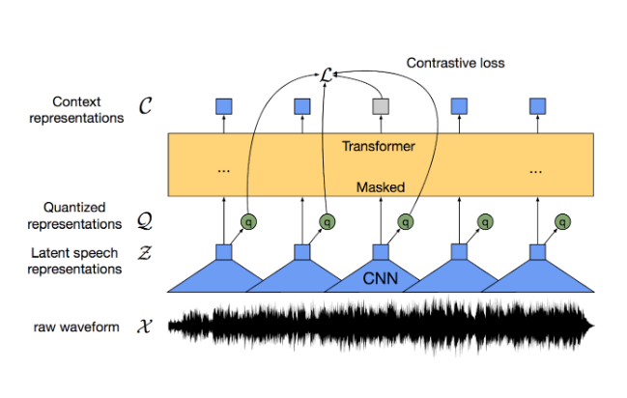
Wav2Vec 2.0
a. Model architecture
The feature encoder, made of several blocks of temporal convolution followed by layer normalization and a GELU activation function, learns a latent representation
The output of the feature encoder is fed to a context network that follows the Transformer architecture
The output of the feature encoder (and not of the context transformer) is discretized in parallel using a quantization module that relies on product quantization, then used as an input to a Gumbel softmax to select the quantized representations

Slide 13
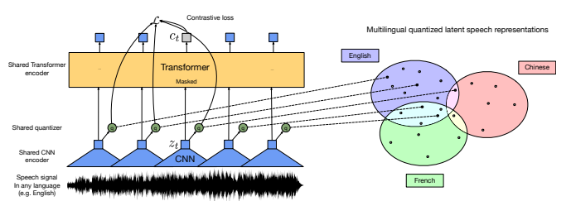
Wav2Vec 2.0 - XLSR
a. Model architecture
The XLSR approach. A shared quantization module over feature encoder representations produces multilingual quantized speech units whose embeddings are then used as targets for a Transformer trained by contrastive learning. The model learns to share discrete tokens across languages, creating bridges across languages.

Slide 14
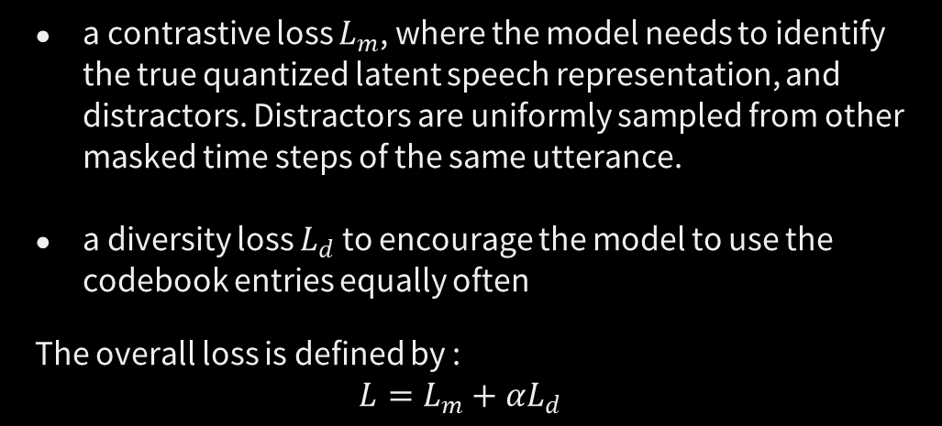
b. Loss function
The loss depends on 2 components
a contrastive loss $L_{m}$, where the model needs to identify the true quantized latent speech representation, and distractors. Distractors are uniformly sampled from other masked time steps of the same utterance.
a diversity loss $L_{d}$ to encourage the model to use the codebook entries equally often
The overall loss is defined by :
$$L=L_{m}+αL_{d}$$

Slide 15
c. Fine tuning
Pre-trained models are fine-tuned for speech recognition by adding a randomly initialized linear projection on top of the context network into C classes representing the vocabulary of the task
For Librispeech, we have 29 tokens for character targets plus a word boundary token. Models are optimized by minimizing a CTC loss.

Slide 16
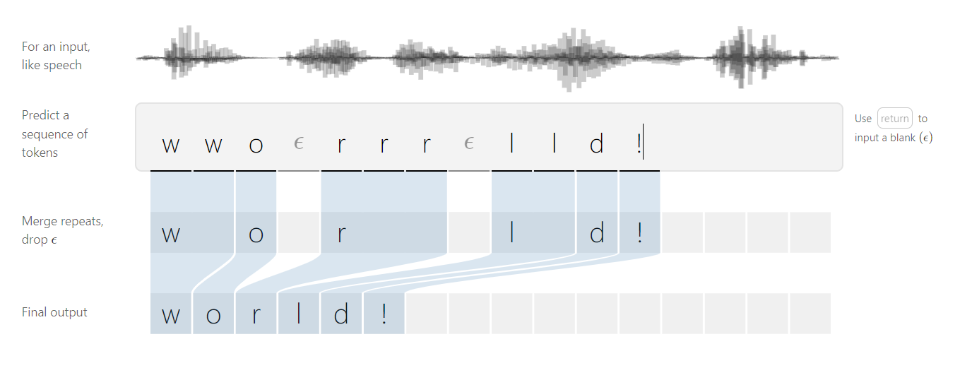
CTC loss
A Connectionist Temporal Classification Loss, is designed for tasks where we need alignment between sequences, but where that alignment is difficult - e.g. aligning each character to its location in an audio file. It calculates a loss between a continuous (unsegmented) time series and a target sequence.

Slide 17
04
Results and Discussion

Slide 18
Word Error Rate
WER is the number of errors divided by the total words.
Word Error Rate = (Substitutions + Insertions + Deletions) / Number of Words Spoken
A substitution occurs when a word gets replaced (for example, “noose” is transcribed as “moose”)
An insertion is when a word is added that wasn’t said (for example, “SAT” becomes “essay tea”)
A deletion happens when a word is left out of the transcript completely (for example, “turn it around” becomes “turn around”)
z

Slide 19
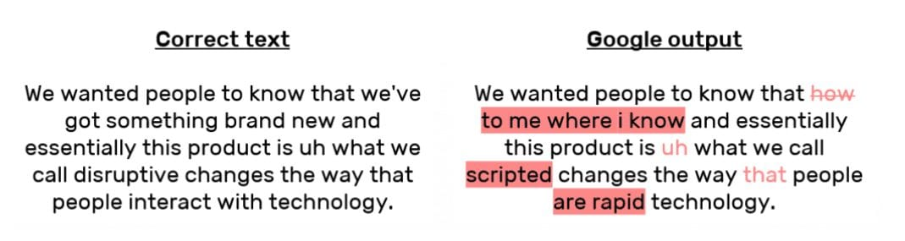
Word Error Rate
Let’s say that a person speaks 29 total words in an original transcription file. Among those words spoken, the transcription included 11 substitutions, insertions, and deletions.
To get the WER for that transcription, you would divide 11 by 29 to get 0.379. That rounds up to .38, making the WER 38 percent.

Slide 20
Results
Spanish (es), French (fr), Italian (it), Kyrgyz (ky), Dutch (du), Russian (ru), Swedish (sv), Turkish (tr), Tatar (tt) and Chinese (zh); as well as English (en)
WER for the Hindi dataset = 73.201856%.

Slide 21
THANKS!

